Slide 1
Real-time Corrosion Product Transport Monitoring Using
On-line Particle Monitors
Joe Zimmerman
Chemtrac Systems, Inc.
Norcross, GA

Slide 2
Introduction
The goal of CPT monitoring is to determine:
when corrosion is occurring
where corrosion is occurring
how much corrosion is occurring

Slide 3
Introduction
The ability to monitor CPT in real-time will
allow for:
System control actions to be taken based on the current corrosion product levels
Measurement of the effects of the adjustments on the corrosion product levels

Slide 4
Introduction
Overview
Steam Cycle Monitoring
Particle Detection Technology
CPT Particle Monitoring
Conclusions

Slide 5
Steam Cycle Monitoring

Slide 6
Steam Cycle Monitoring
Traditional Methods
Soluble
  Grab sample tests
    Metals analysis, various other lab analyses
  On-line analyzers
    Cation conductivity, sodium, silica, pH, etc.
  Composite sampling
    Ion exchange columns, resin-impregnated filter pads

Slide 7
Steam Cycle Monitoring
Traditional Methods
Insoluble
  Grab sample tests
    Millipore pads, TSS, lab particle analyses
  On-line analyzers
    Turbidity monitors
  Composite sampling
    Corrosion Product Monitor filter pads

Slide 8
Steam Cycle Monitoring
On-line Particle Analysis
provides real-time indication of insoluble particulate loading
allows for continuous data collection & trending

Slide 9
Particle Detection Technology

Slide 10
Particle Detection Technology
Turbidity Monitors utilize a “light scattering” measurement
Particle Counters & Particle Monitors utilize a “light blockage” measurement

Slide 11
Particle Detection Technology
Turbidity Monitor
Lens
Lamp
0.30 NTU
0.00 NTU
Photo Detector

Slide 12
Particle Detection Technology
Light Beam
Particles
Laser Diode
Or LED
Photo Diode
Water Flow

Slide 13
Particle Detection Technology
Particle Counter & Particle Monitor
Detect particles > 2 microns
1 particle/mL sensitivity
<10 PPT detection capability

Slide 14
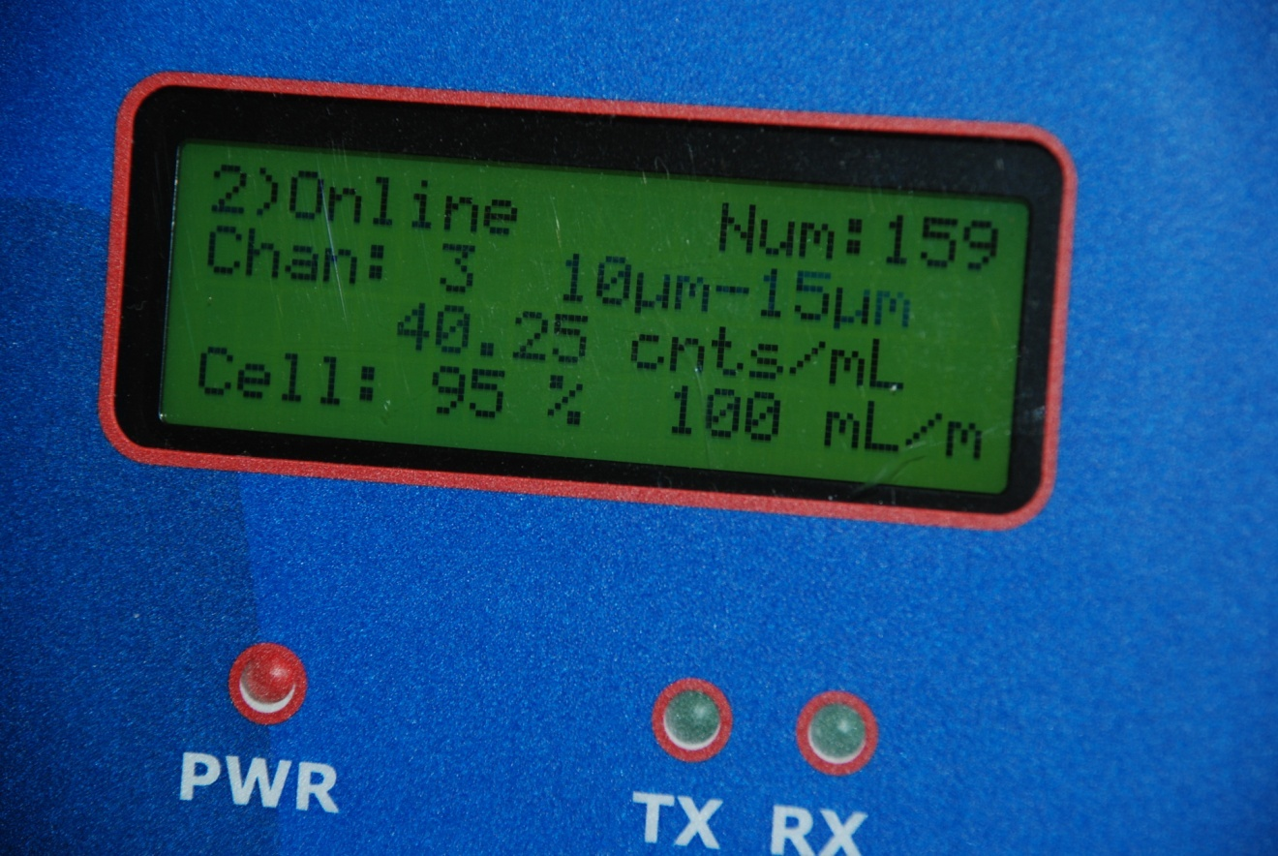
Particle Detection Technology
Particle Counter
Reports results in counts/mL for up to 8 size ranges
Allows for size/count distribution profiles

Slide 15
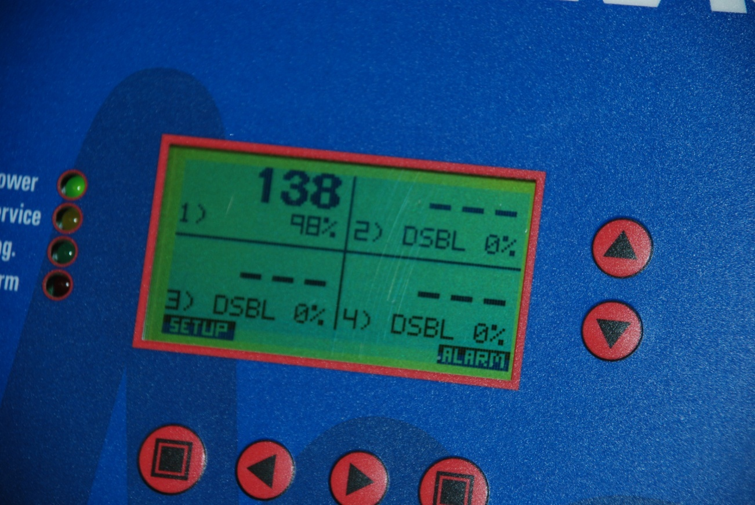
Particle Detection Technology
Particle Monitor
Single channel device, producing a “relative” measurement called a Particle Index (PI)
The PI will increase with both an increase in particle size and concentration

Slide 16
Particle Detection Technology
Particle Counter, Particle Monitor, Turbidity Monitor
How Are Particles Detected?

Slide 17
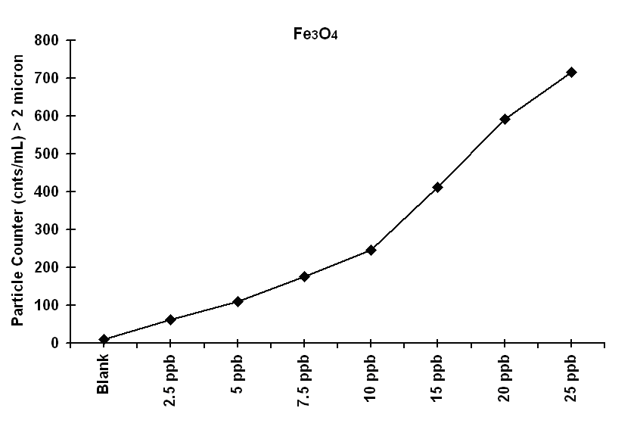
Particle Detection Technology
Magnetite

Slide 18
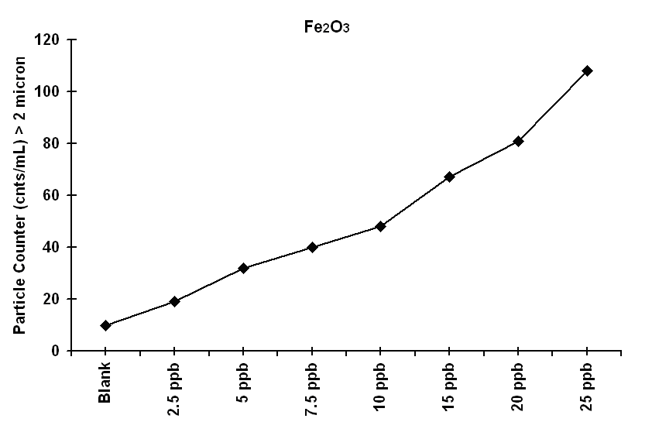
Particle Detection Technology
Hematite

Slide 19
CPT Particle Monitoring

Slide 20

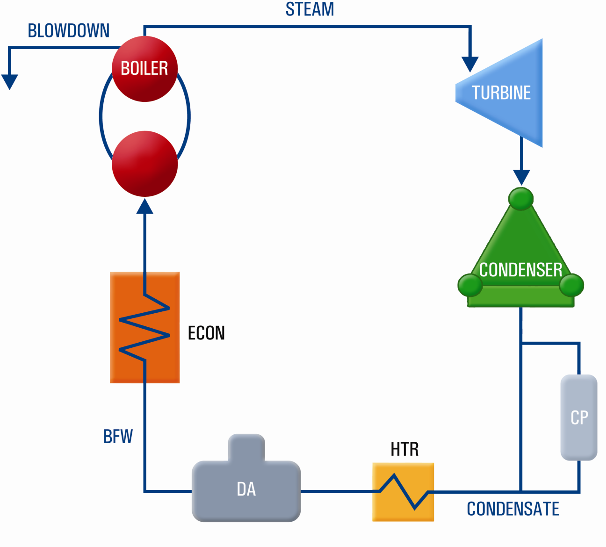
CPT Particle Monitoring
Steam Generation Cycle

Slide 21
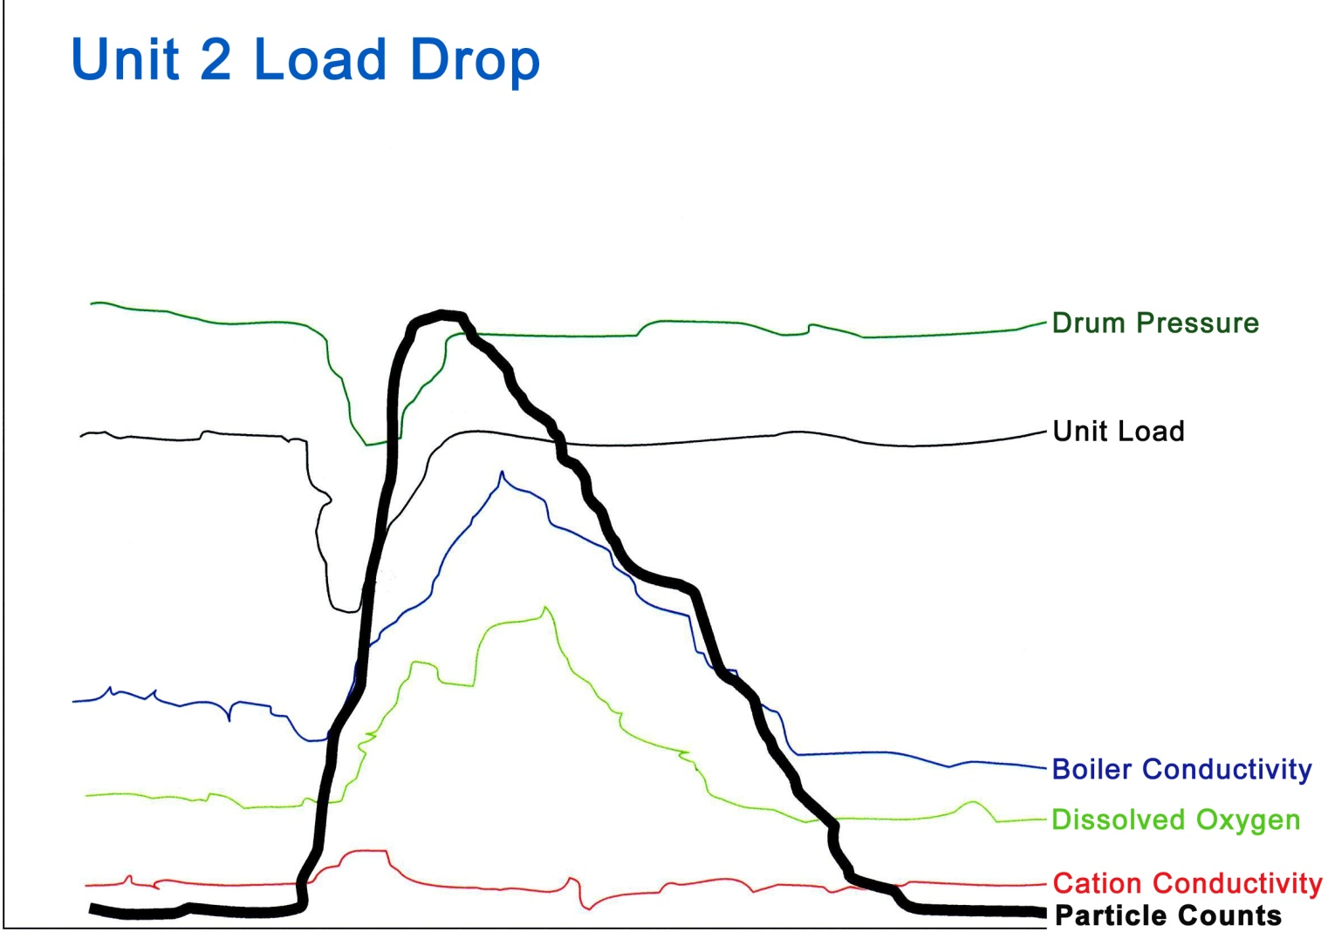
CPT Particle Monitoring
Particle Counts During Load Change

Slide 22
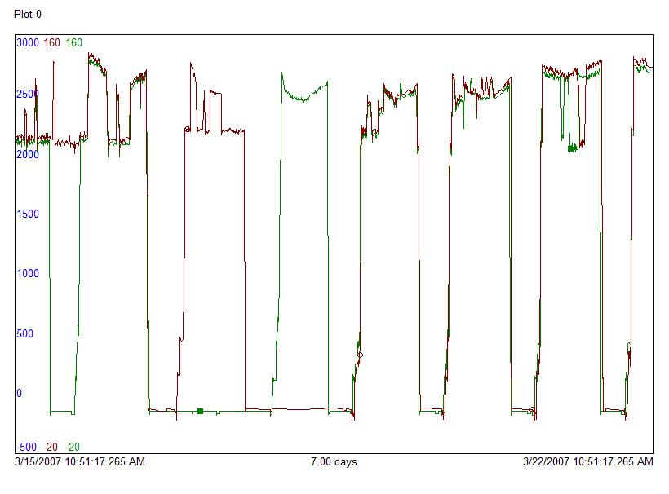
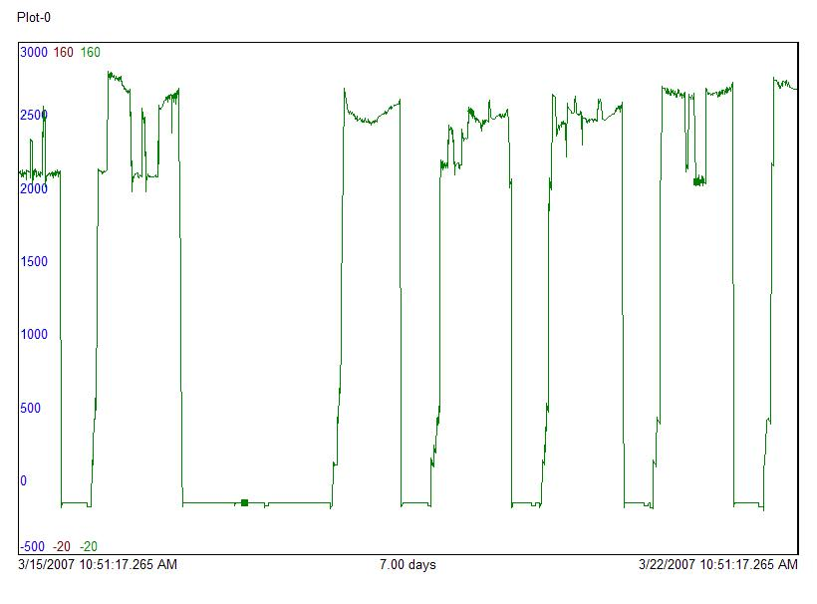
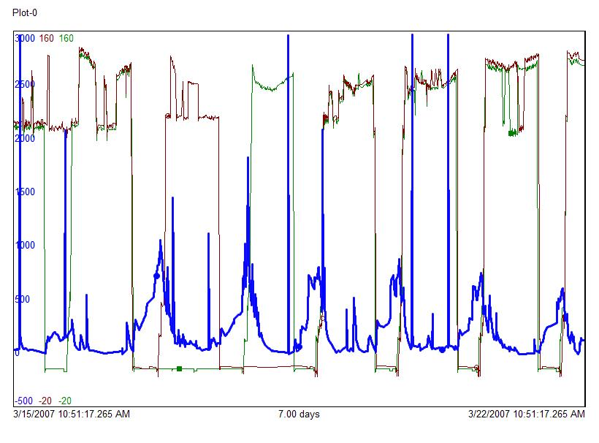
CPT Particle Monitoring
HRSG 1 MW, HRSG 2 MW
HRSG 1 MW, HRSG 2 MW, Particle Index
HRSG 1 MW

Slide 23
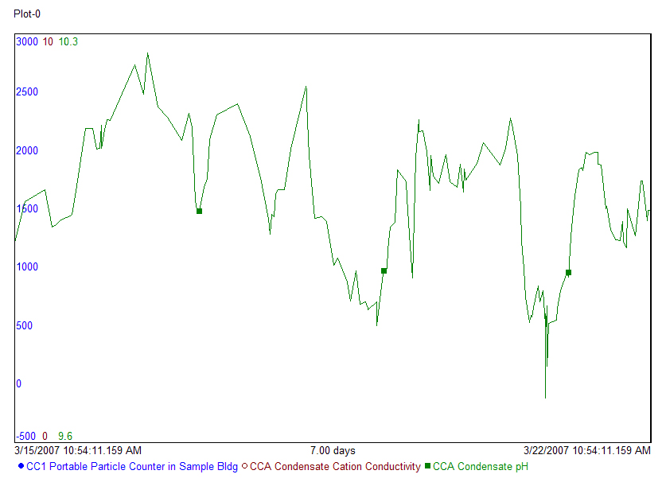
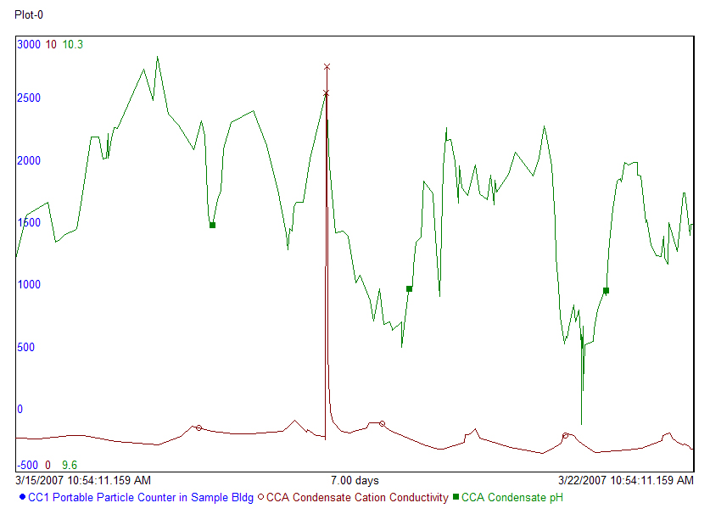
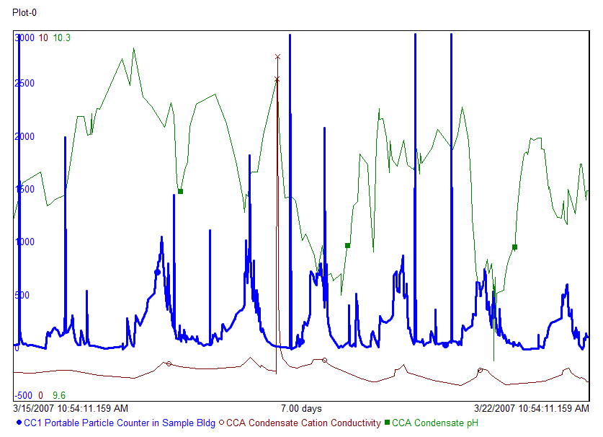
CPT Particle Monitoring
Condensate pH,
Condensate
Condensate pH, Cation Conductivity,
Condensate pH, Cation Conductivity & Particles

Slide 24
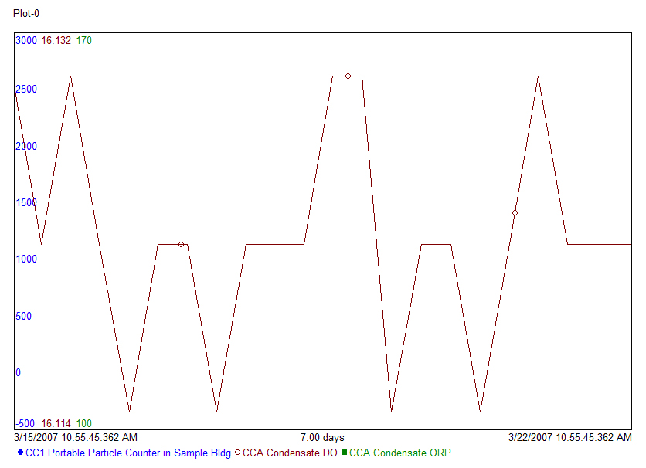
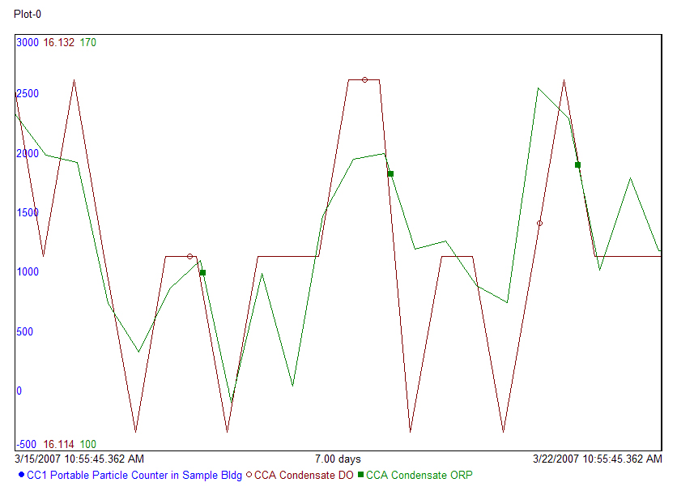
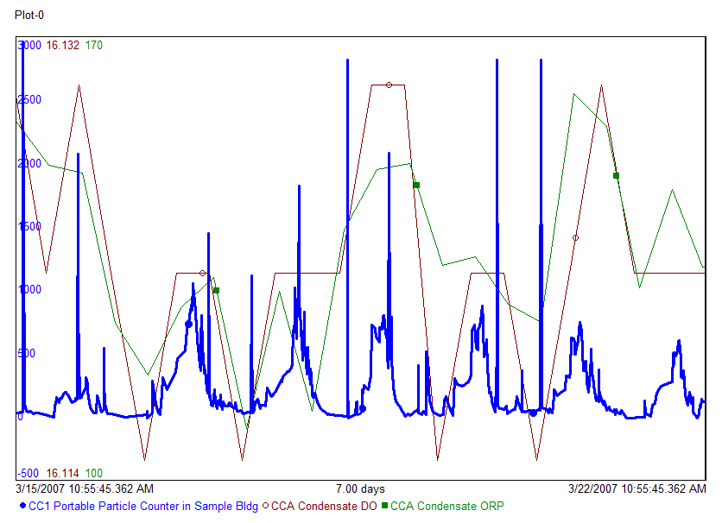
CPT Particle Monitoring
Condensate DO,
Condensate DO, ORP
Condensate DO, ORP, & Particles

Slide 25
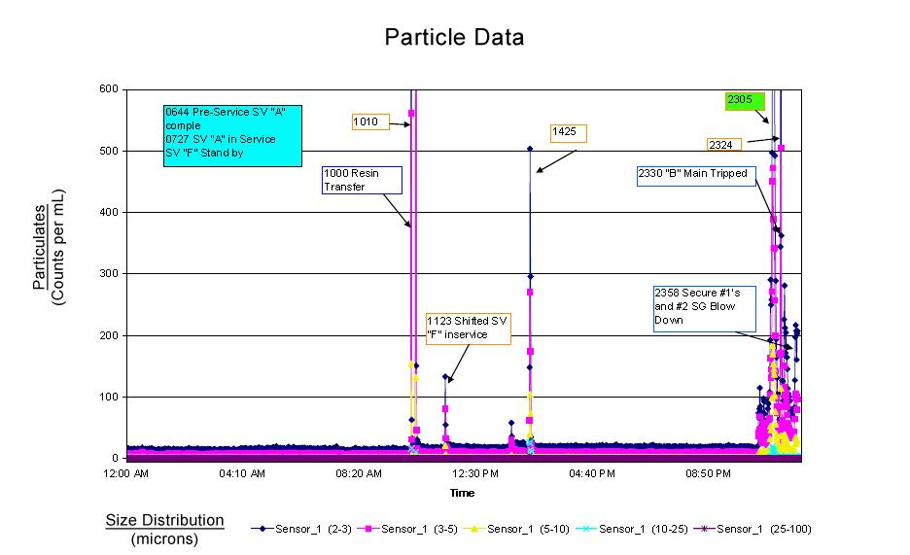
CPT Particle Monitoring
Nuclear Plant – Iron Transport Data

Slide 26
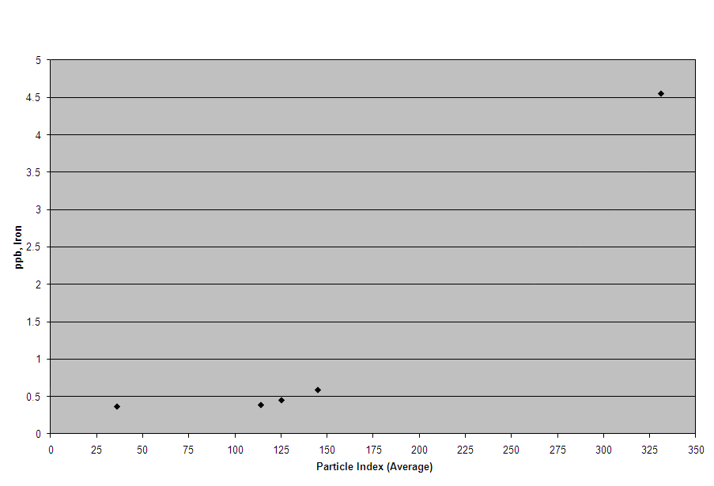
CPT Particle Monitoring
Fossil Plant – CPM Iron vs. Particle Index Average

Slide 27
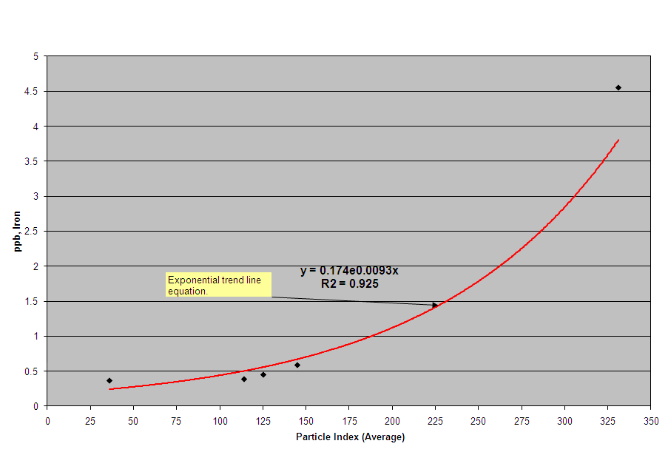
CPT Particle Monitoring
Fossil Plant – CPM Iron vs. Particle Index Average

Slide 28
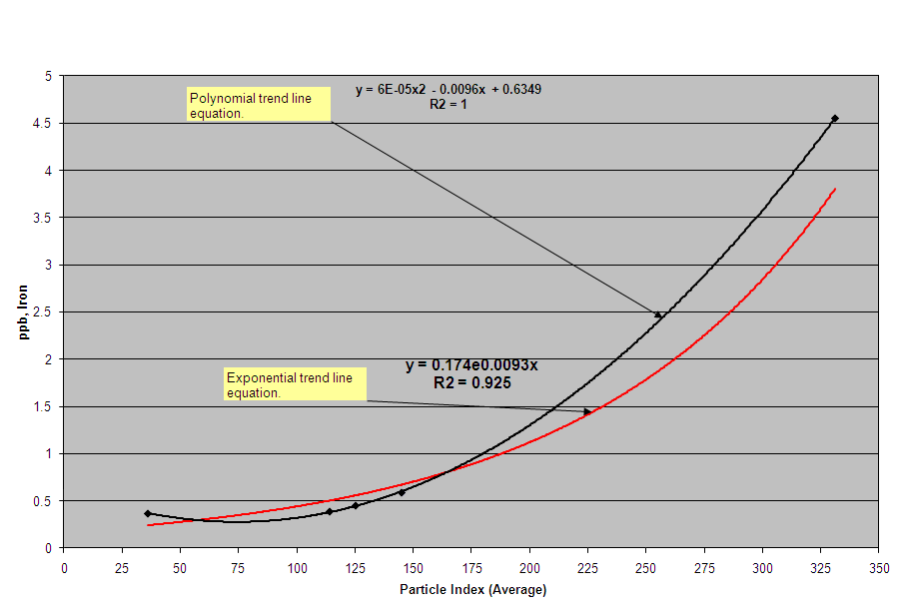
CPT Particle Monitoring
Fossil Plant – CPM Iron vs. Particle Index Average

Slide 29
Conclusions

Slide 30
Conclusions
On-line Particle Monitoring:
Provides continuous tracking of insoluble metal oxides…a clear advantage over “grab” or “composite” sampling
Complements existing online ionic analyzers, offering additional analytical trends for system performance evaluation
Offers real-time CPT results…treatment program adjustments can be made, and subsequent effects on CPT levels can be measured
Allows for real-time recognition of CPT “events” such that immediate actions can be considered when an event occurs

