Slide 1
Focus Topic: Misting for Megawatts
ACCUG 2025
Andrew Howell, discussion facilitator
Granbury, TX
July 29-31, 2025

Slide 2
Loss of Generation in Hot Weather
  Elevated backpressure in ACC due to high ambient T
  (Note the effect of temperature on combustion turbines)

Slide 3
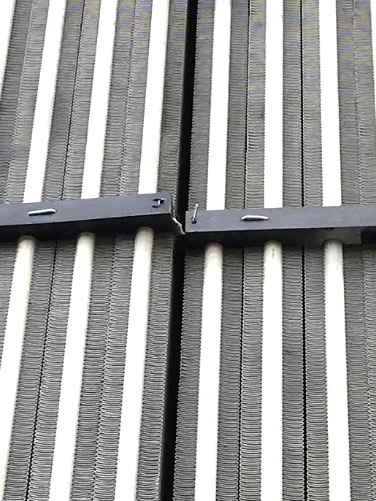
Options to resolve poor vacuum in ACC MW loss
Marginal: actions that will improve vacuum but not likely completely resolve
reduce air in-leakage / plug gaps
increase ACC size with additional rows
increase fan speed
reduce effects of wind on fans
routine fin cleaning
Note: while ‘marginal resolution’ issues cannot in themselves provide full generating capacity in hot weather, those that have a significant influence on performance degradation may very well be cost-effective to implement.

Slide 4
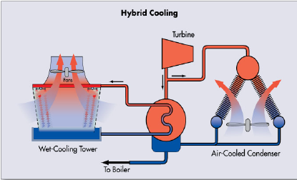
Options to resolve poor vacuum in ACC MW loss
Complete resolution: appropriate application of evaporative cooling support
water misting
parallel cooling with water-cooled condenser
deluge system
Note: ‘complete resolution’ requires that ‘marginal resolution’ issues are adequately addressed, particularly those that have a significant influence on performance degradation.

Slide 5
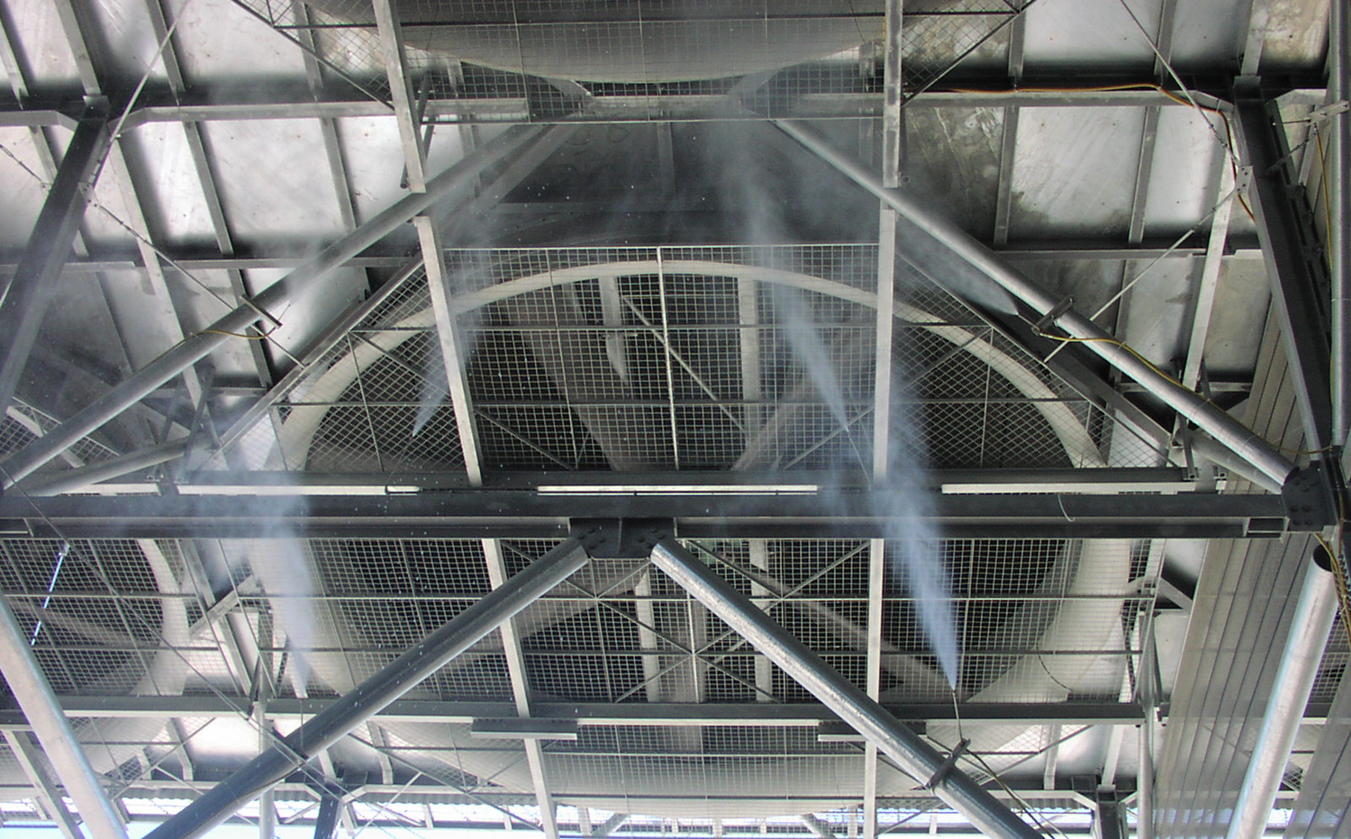
Water Misting for ACCs
Appears simple & effective at first thought, but actually is challenging to optimize
typically applied upstream of fans
applied as droplets
some droplets collect on fan blades and are thrown to the shroud then to ground
droplets that reach fins must be low in mineral content or will form scale
evaporation on air vs. on fins
Outcome: inefficient use of expensive water with upstream misting
application has been primarily for very limited use per availability requirements

Slide 6
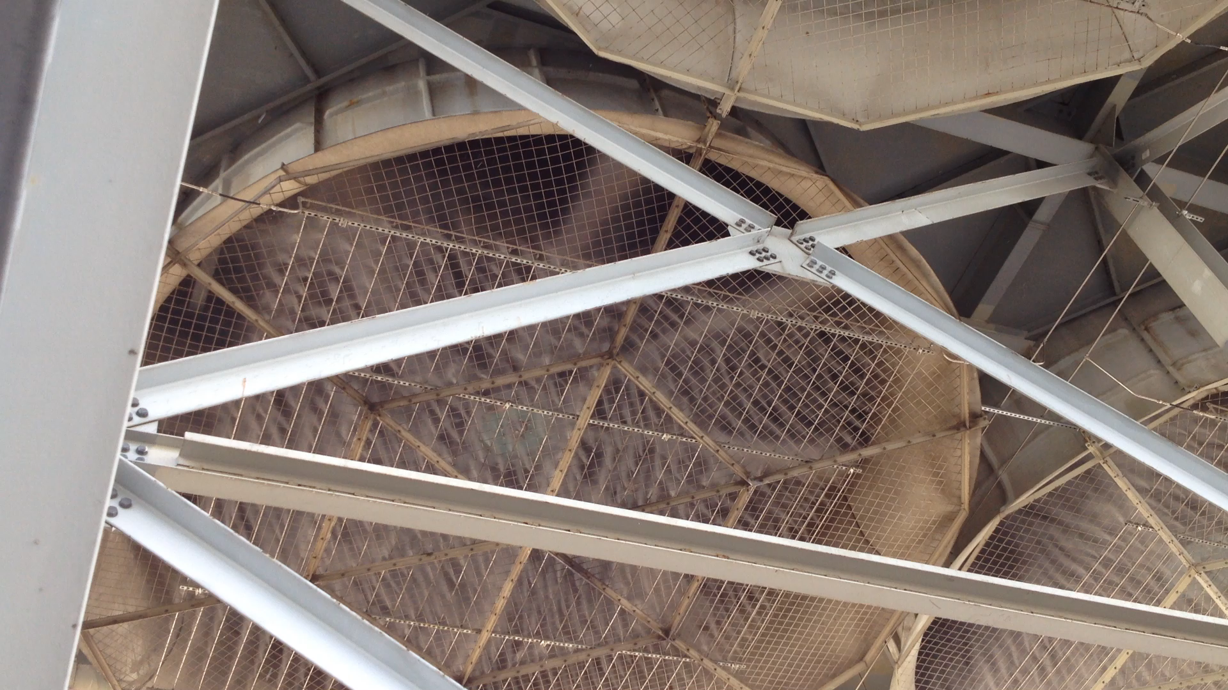
Misting upstream of fans: 1 of 2

Slide 7
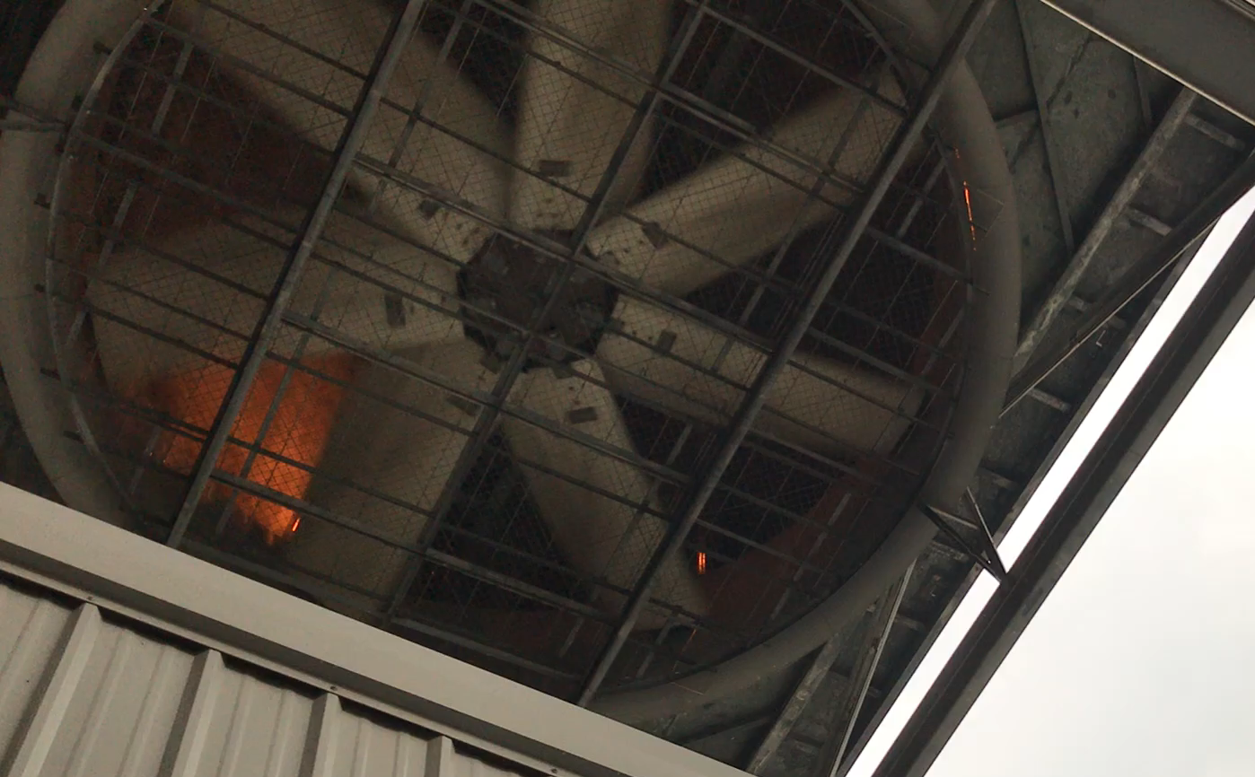
Misting upstream of fans: 2 of 2

Slide 8
Considerations regarding misting effectiveness
Science: misting objective – cool air / fins to counter high ambient temperatures
droplets must evaporate to enact significant cooling
  prior to fins or after depositing on fins
small droplets evaporate more quickly, more completely
  generating smaller droplets increases risk of nozzle clogging, pressure requirements

Slide 9
Considerations regarding misting effectiveness
Local cooling promotes pooling
droplets depositing on fins may cool the metal faster than condensate can provide heat to promote evaporation
  result is flowing water that does not completely evaporate
very small droplets that evaporate to cool the air may be preferred

Slide 10
Considerations regarding misting effectiveness
Introduction of mist downstream of fans
not a completely novel concept; note Coryton’s 2002 installation
fans blow dispersed small droplets toward fins
  no opportunity for droplets to collect on fan blades
potential inefficiencies:
  droplets passing through fins (low probability due to fin position)
    note that extremely small droplets may be more likely to pass through fins
  water accumulation on fins / shedding (inside or outside fan bay)
  rate of evaporation / droplet size

Slide 11
Water purity considerations
Demineralized water is ideal for avoiding scale, but costly for routine use
demineralization (perhaps following reverse osmosis): water ~0.06 µS/cm
extent of demineralization:
  source water ~150-750 µS/cm
  single-pass reverse osmosis ~10-15 µS/cm
  double-pass reverse osmosis ~1 µS/cm
mineral issues
  requires droplets drying on fins / tubes rather than completely in air
  frequency of use considerations
    increased mineral buildup with increased use
    minimal use may not require highest purity
    more frequent use requires higher purity
  water composition – the quantities of scaling constituents present

Slide 12
Summary
Applying misting to the upstream side of ACC fans has not proven an efficient use of very costly water. While it is possible that the evaporation inefficiencies might be overcome, it is worthwhile to examine possible benefits from supplying mist to the downstream side of ACC fans.
Issues that may be obstacles to effective downstream application of misting should be carefully evaluated to optimize design; ideally, this approach and associated issues (e.g. scaling) should be tested on a pilot-scale in an operating ACC.

Slide 13
Discussion / Questions

